Slide 1


www.globalbigdataconference.com
Twitter : @bigdataconf

Slide 2
NLP workshop by SK Reddy skreddy99@gmail.com https://www.linkedin.com/in/s-k-reddy-3473763/

Slide 3
Instructions to all attendees
Unzip and load all the files in the zip file. Make sure that you have these files in a single directory
weights-improvement-19-1.9435.hdf5
fundamental_keras_model.py
generate_text_largeLSTM.py
weights_generation.py
weights_generation_largeLSTM.py
Wonderland.txt
generate_text.py
word2vec.py
classifier.py
Stop_words_ipynb
If you do not have python installed in your machine, download any free online python IDE. I have used PyCharm Community edition (2016.3).

Slide 4
Install the following
Please download nltk and all the text corpora available at http://www.nltk.org/
Also install the following packages from online free resources: In my experience anaconda (https://www.continuum.io/downloads) is a good package manager that MAY serve all your needs. Check that you have installed the packages correctly
Numpy,
Pandas,
Tensorflow,
Keras

Slide 5
Lets start NLP

Slide 6
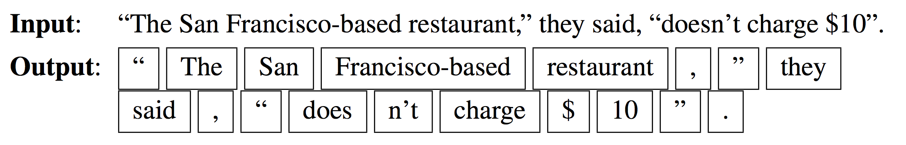
Word Tokenization
Ref: Speech and Language Processing. Daniel Jurafsky & James H. Martin. https://web.stanford.edu/~jurafsky/slp3/28.pdf

Slide 7
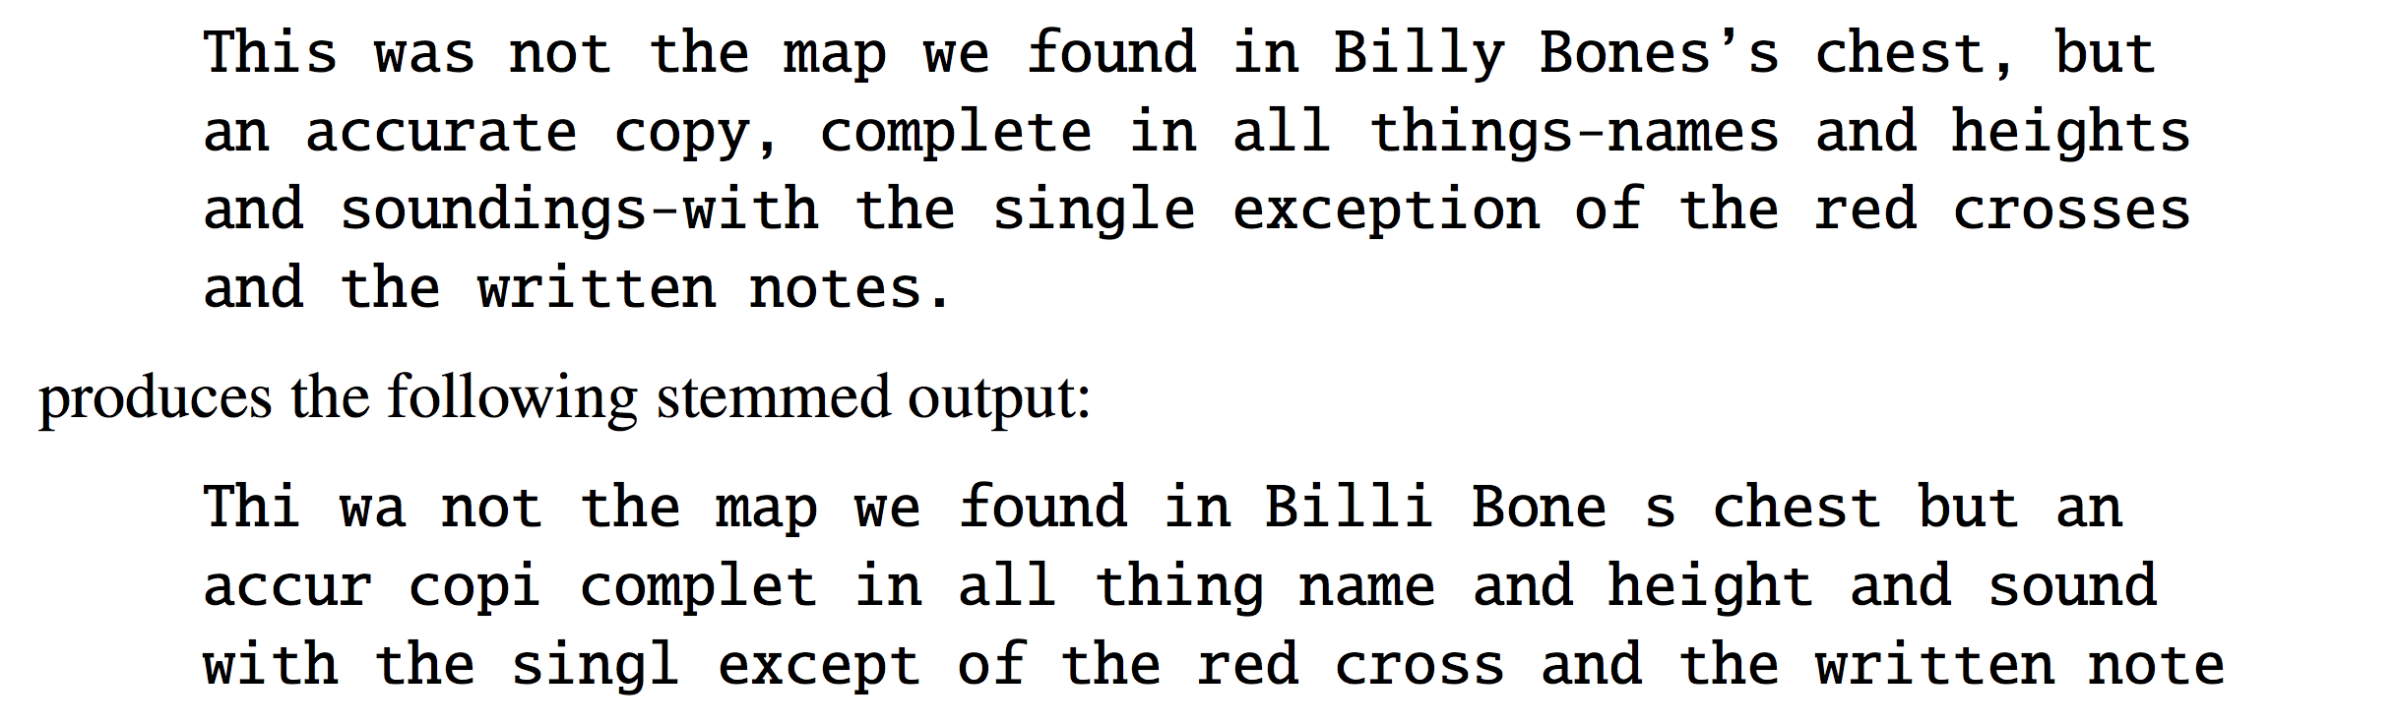
Lemmatization and Stemming
Ref: Speech and Language Processing. Daniel Jurafsky & James H. Martin. https://web.stanford.edu/~jurafsky/slp3/28.pdf

Slide 8
Open a jupyter notebook using anaconda navigator
>>> import nltk
>>> nltk.download()
>>> text = nltk.word_tokenize("And now for something completely different")
>>> nltk.pos_tag(text)
[('And', 'CC'), ('now', 'RB'), ('for', 'IN'), ('something', 'NN'),
('completely', 'RB'), ('different', 'JJ')]
>>> text = nltk.word_tokenize("They refuse to permit us to obtain the refuse permit")
>>> nltk.pos_tag(text)
[('They', 'PRP'), ('refuse', 'VBP'), ('to', 'TO'), ('permit', 'VB'), ('us', 'PRP'),
('to', 'TO'), ('obtain', 'VB'), ('the', 'DT'), ('refuse', 'NN'), ('permit', 'NN')]
Ref: http://www.nltk.org/book/ch05.html

Slide 9
The text.similar() method takes a word w, finds all contexts w1w w2, then finds all words w' that appear in the same context, i.e. w1w'w2.
Open a jupyter notebook using anaconda navigator
>>> text = nltk.Text(word.lower() for word in nltk.corpus.brown.words())
>>> text.similar('woman')
Building word-context index...
man day time year car moment world family house boy child country job
state girl place war way case question
>>> text.similar('bought')
made done put said found had seen given left heard been brought got
set was called felt in that told
>>> text.similar('over')
in on to of and for with from at by that into as up out down through
about all is
>>> text.similar('the')
a his this their its her an that our any all one these my in your no
some other and
Ref: http://www.nltk.org/book/ch05.html

Slide 10
Hands-on: Stop words
Open a jupyter notebook using anaconda navigator
>>>from nltk.corpus import stopwords
>>>set(stopwords.words('english'))
https://pythonprogramming.net/stop-words-nltk-tutorial/?completed=/tokenizing-words-sentences-nltk-tutorial/

Slide 11
1. Open python IDE (for example PyCharm Community edition)
2. Open the file “Stopwords_full.py”
Type the following sentence in place of ????:
“This is a test to check how to filter stop words in nltk.”
1. Open python IDE (for example PyCharm Community edition)
2. Open the file “stemmer_full.py”
Type the following sentence in place of ????:
"john","johner","johning","johned","johnly"

Slide 12
POS tag list:
CC coordinating conjunction
CD cardinal digit
DT determiner
EX existential there (like: "there is" ... think of it like "there exists")
FW foreign word
IN preposition/subordinating conjunction
JJ adjective 'big'
JJR adjective, comparative 'bigger'
JJS adjective, superlative 'biggest'
LS list marker 1)
MD modal could, will
NN noun, singular 'desk'
NNS noun plural 'desks'
NNP proper noun, singular 'Harrison'
NNPS proper noun, plural 'Americans'
PDT predeterminer 'all the kids'
POS possessive ending parent's
PRP personal pronoun I, he, she
PRP$ possessive pronoun my, his, hers
RB adverb very, silently,
RBR adverb, comparative better
RBS adverb, superlative best
RP particle give up
TO to go 'to' the store.
UH interjection errrrrrrrm
VB verb, base form take
VBD verb, past tense took
VBG verb, gerund/present participle taking
VBN verb, past participle taken
VBP verb, sing. present, non-3d take
VBZ verb, 3rd person sing. present takes
WDT wh-determiner which
WP wh-pronoun who, what
WP$ possessive wh-pronoun whose
WRB wh-abverb where, when

Slide 13
Sentiment analyses
1. Open python IDE (for example PyCharm Community edition)
2. Open and Run classifier.py

Slide 14
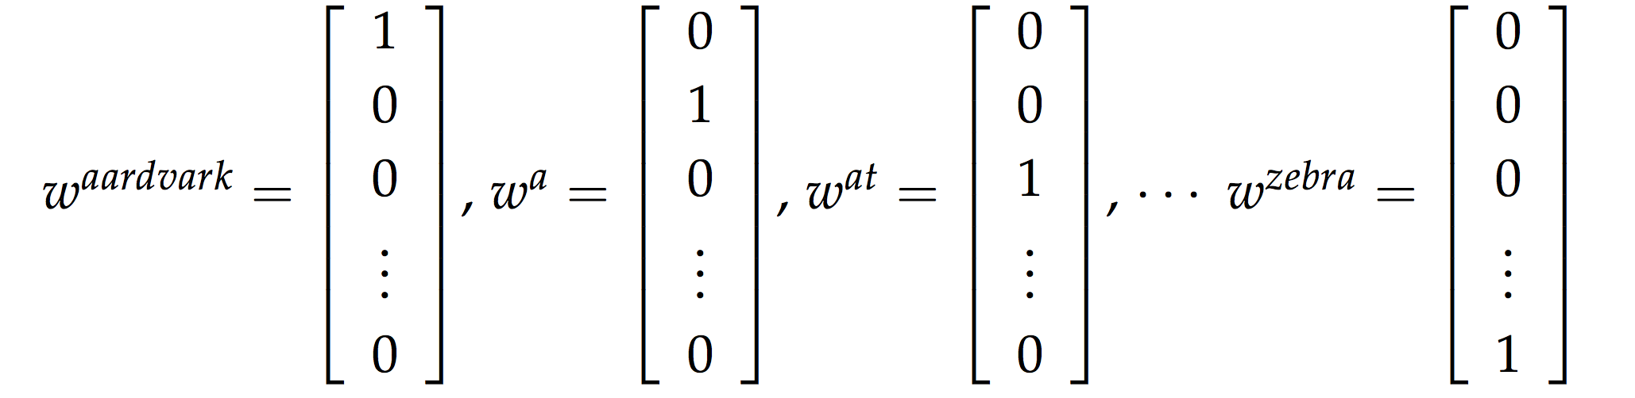
Word vectors (One-hot vectors)
Ref: http://cs224d.stanford.edu/lecture_notes/LectureNotes1.pdf

Slide 15
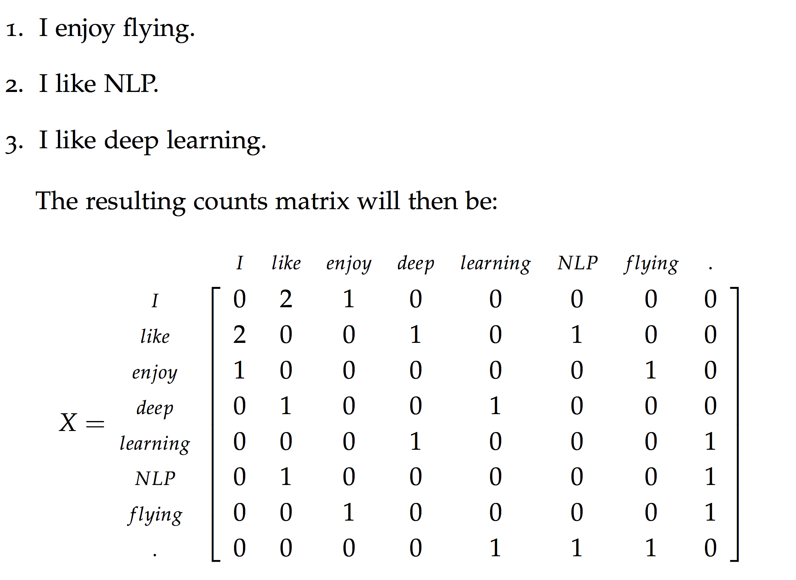
Word vectors (Word-Word co-occurrence matrix)
Ref: http://cs224d.stanford.edu/lecture_notes/LectureNotes1.pdf

Slide 16

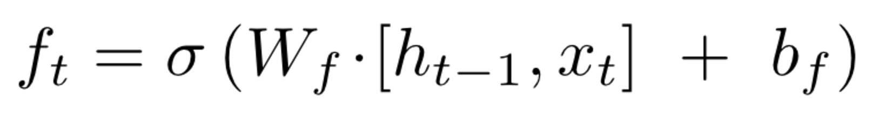
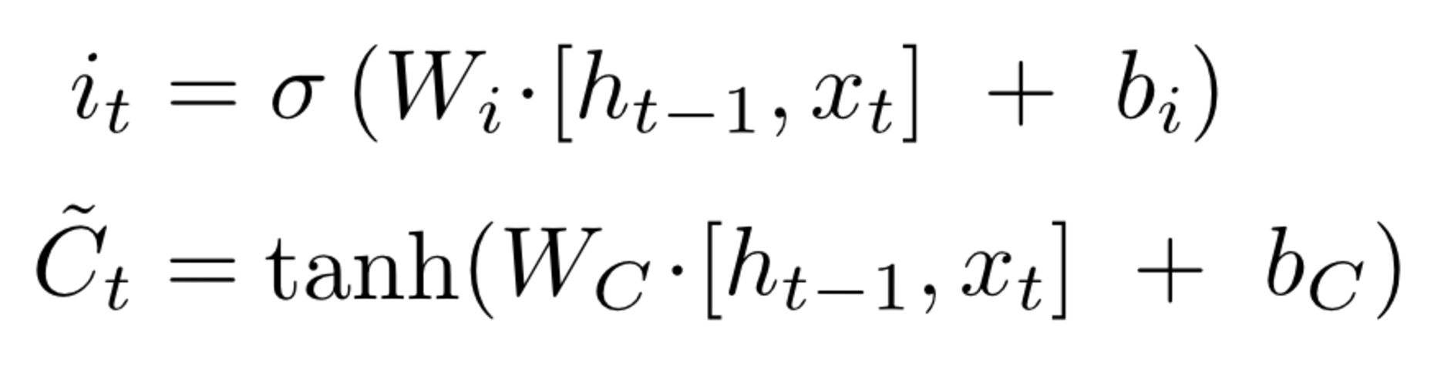
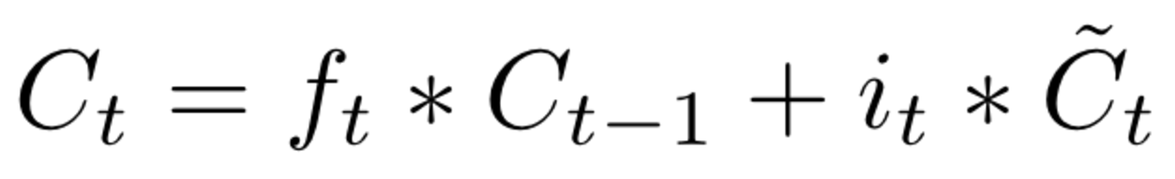
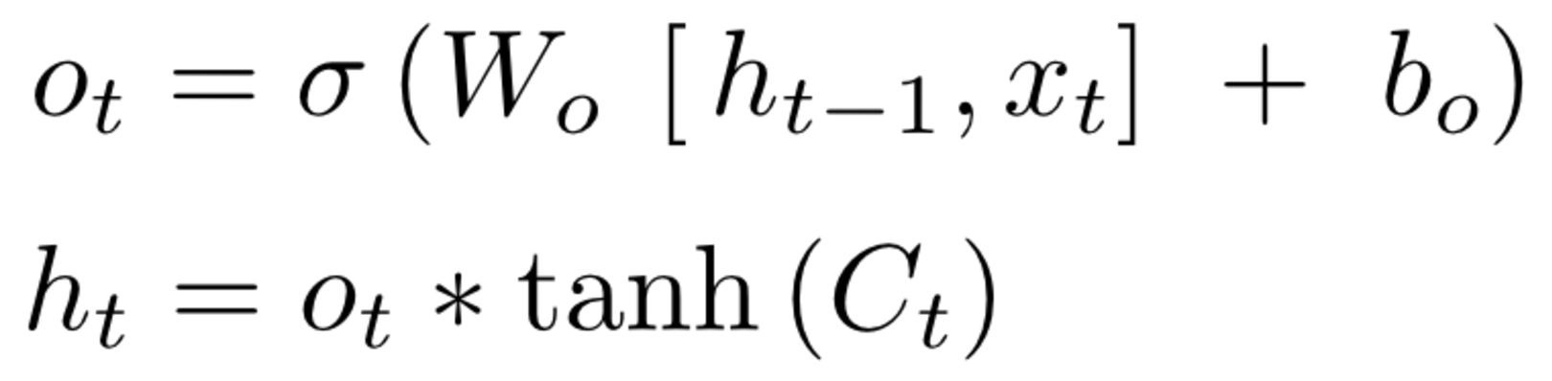
LSTM
f_{t}
i_{t}
o_{t}
Ref: http://colah.github.io/posts/2015-08-Understanding-LSTMs/

Slide 17
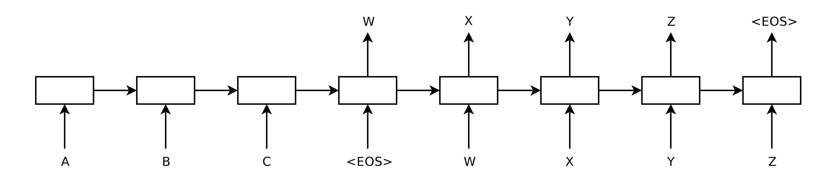
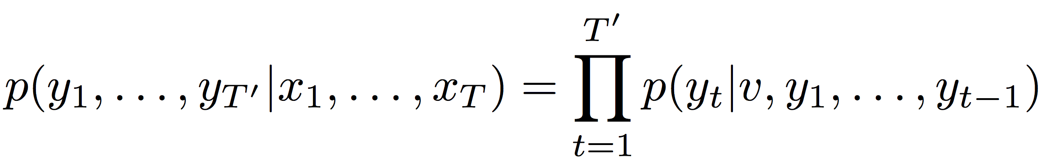
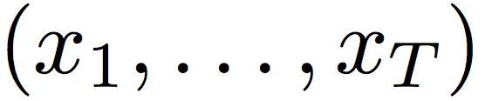
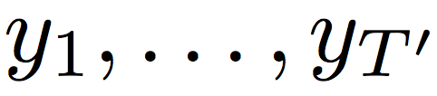
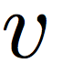
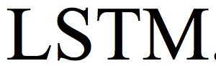
Seq2Seq
where
is input sequence
is corresponding output sequence
Ref: Sequence to Sequence Learning with Neural Networks; https://arxiv.org/pdf/1409.3215.pdf

Slide 18
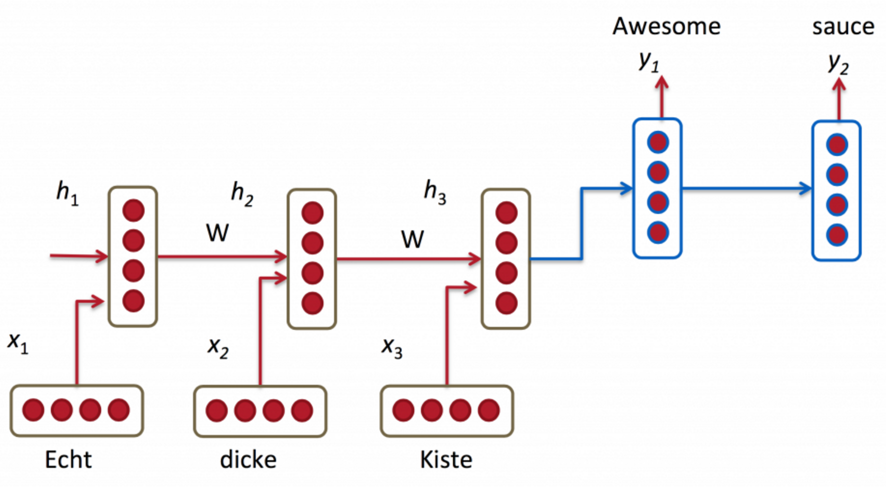
Encoder-Decoder
Ref: http://www.wildml.com/2016/01/attention-and-memory-in-deep-learning-and-nlp/

Slide 19
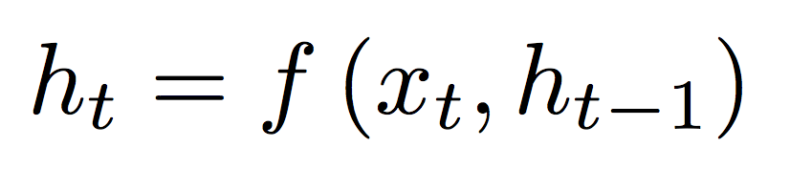
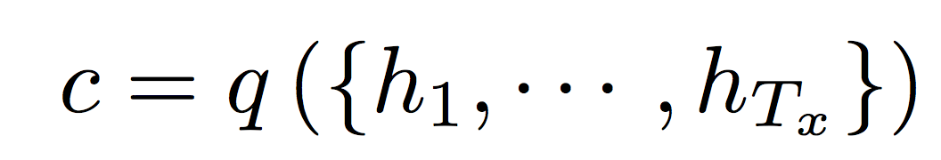
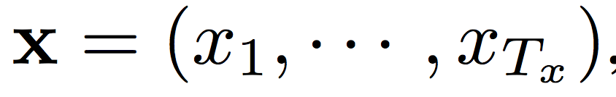
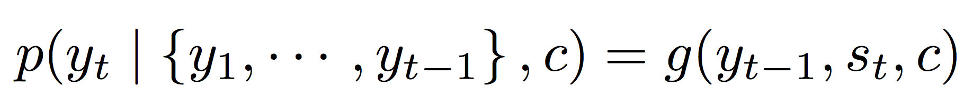
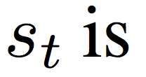
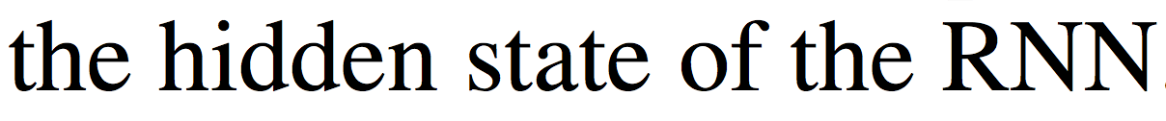
Hidden state
Encoder
Output vector
reads the inputs
inputs
Decoder
predicts the next word
Ref: NEURAL MACHINE TRANSLATION BY JOINTLY LEARNING TO ALIGN AND TRANSLATE; https://arxiv.org/pdf/1409.0473.pdf

Slide 20
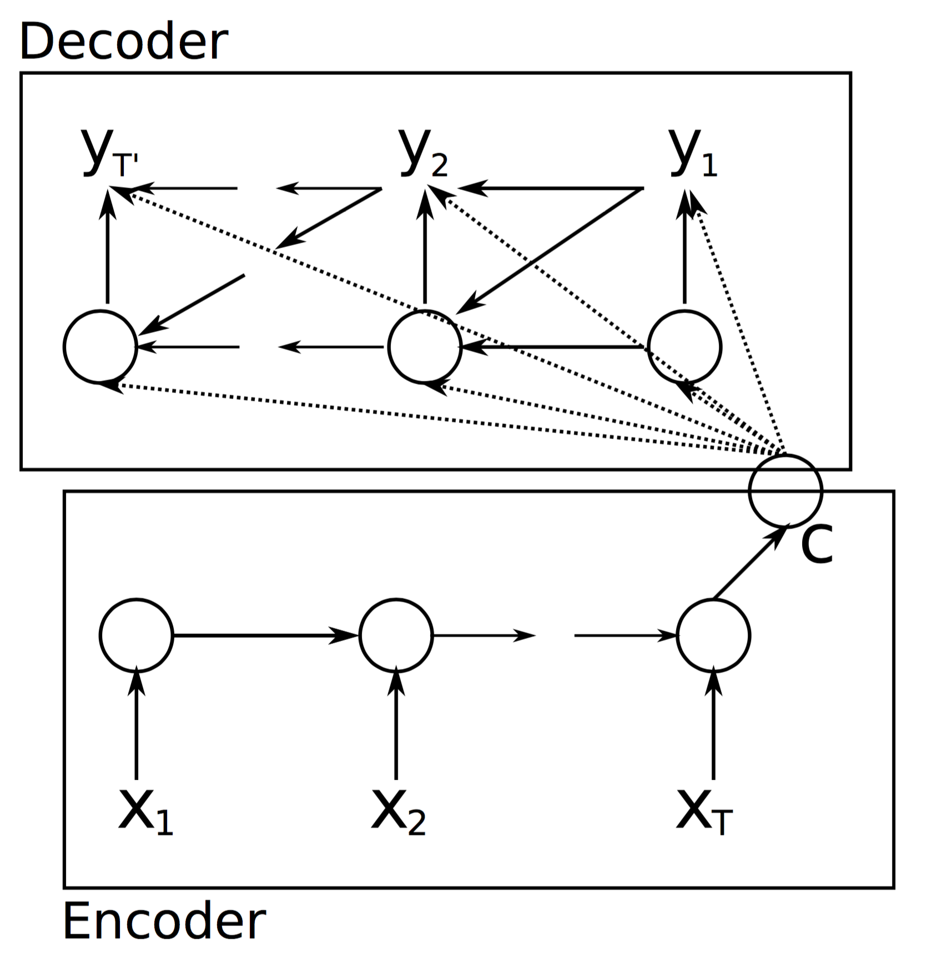
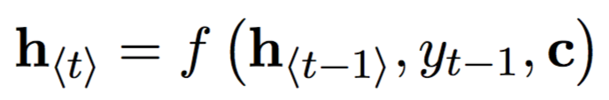
Encoder-Decoder with a ‘peek’
Ref: Learning Phrase Representations using RNN Encoder–Decoder for Statistical Machine Translation; https://arxiv.org/pdf/1406.1078.pdf

Slide 21
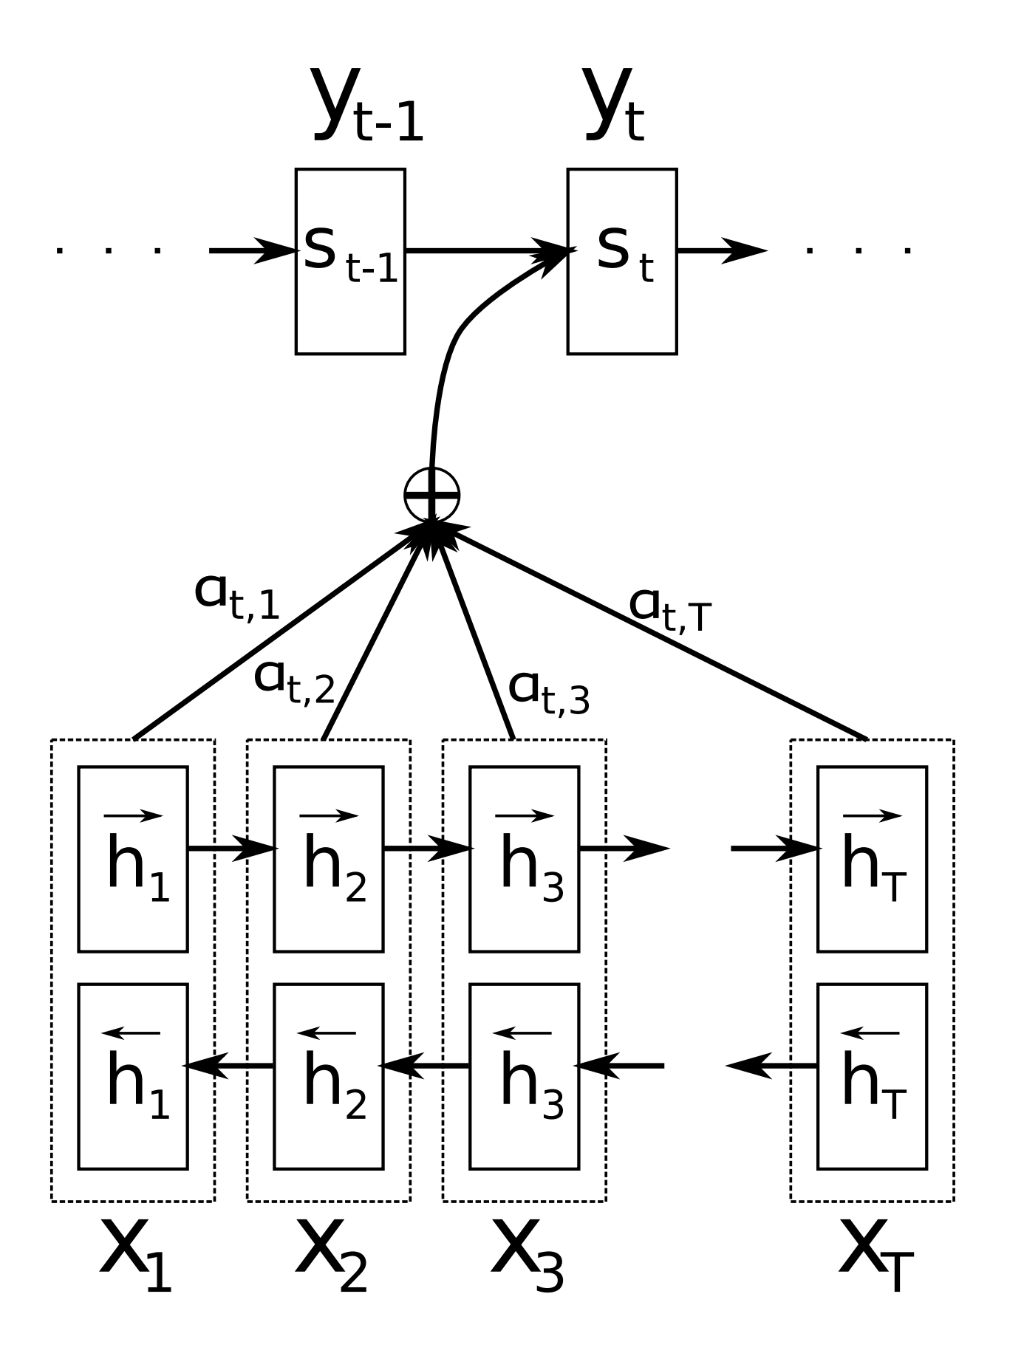
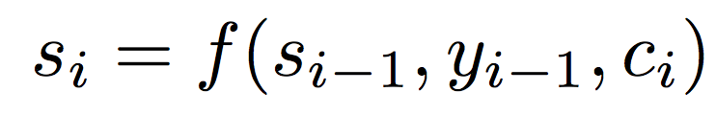
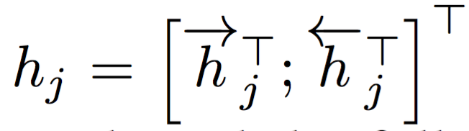
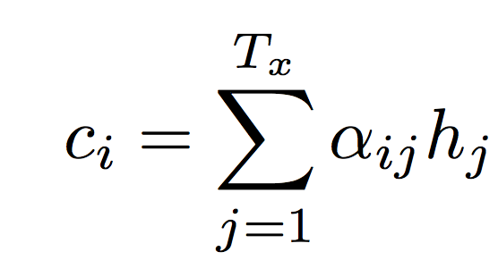
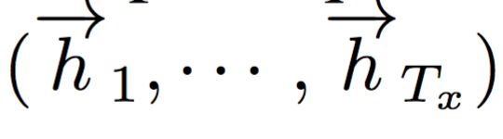
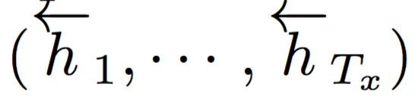
Attention
where
are forward hidden states
are backward hidden states
Ref: NEURAL MACHINE TRANSLATION BY JOINTLY LEARNING TO ALIGN AND TRANSLATE; https://arxiv.org/pdf/1409.0473.pdf

Slide 22
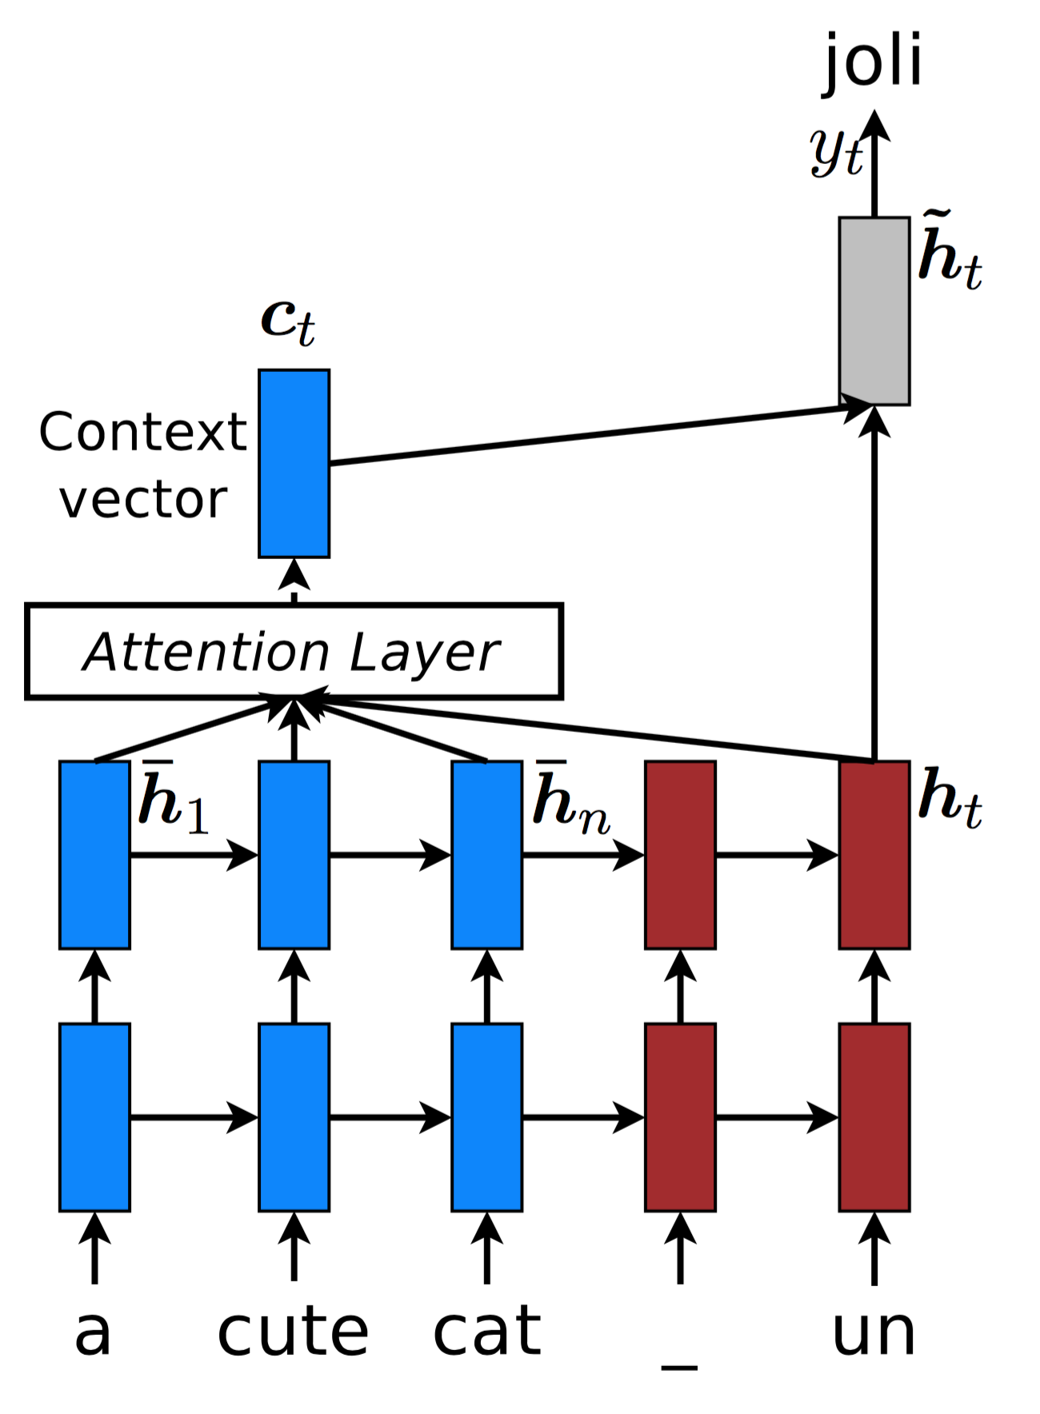
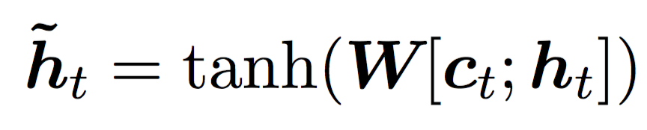
Attention (word-character level model)
Ref: Achieving Open Vocabulary Neural Machine Translation with Hybrid Word-Character Models; https://arxiv.org/pdf/1604.00788.pdf

Slide 23
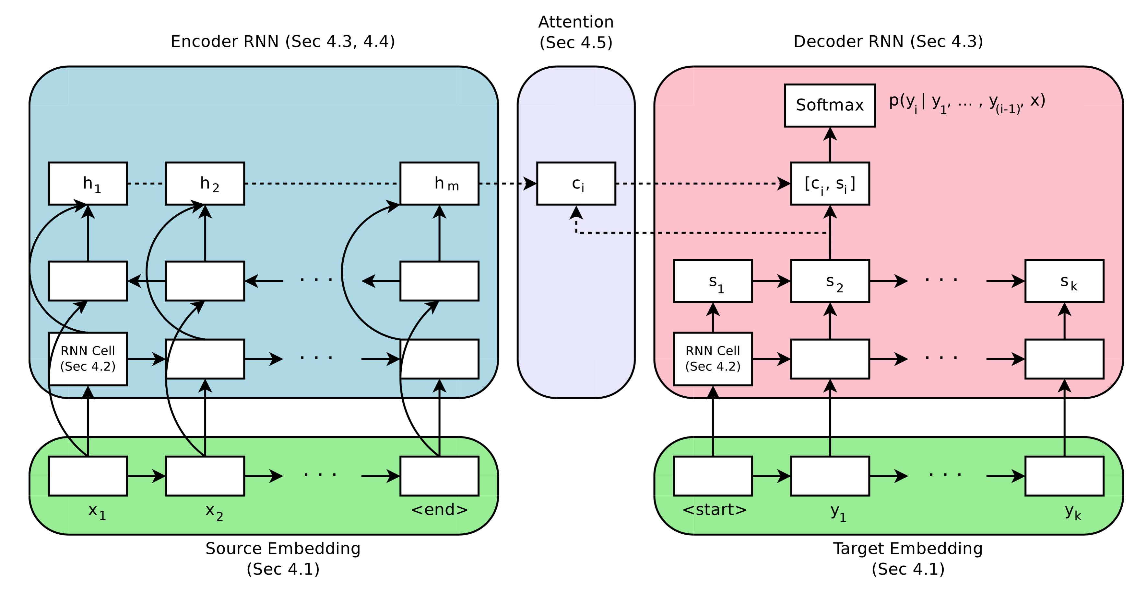
Attention
Ref: Massive Exploration of Neural Machine Translation Architectures; https://arxiv.org/pdf/1703.03906.pdf
Results:
LSTMs are better (than GRUs)
Shallow networks perform as good (as deep ones)
Deep encoders more difficult to optimize (than decoders)

Slide 24
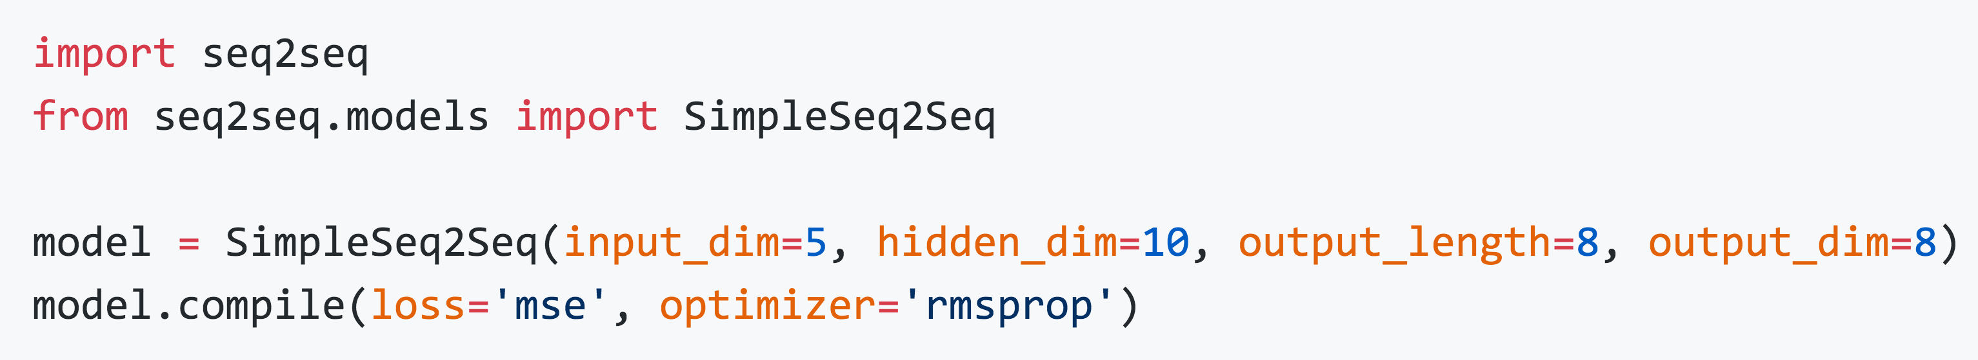
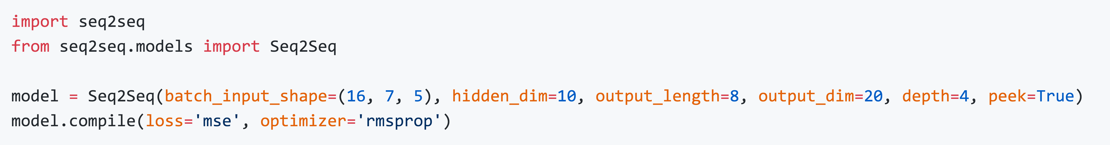
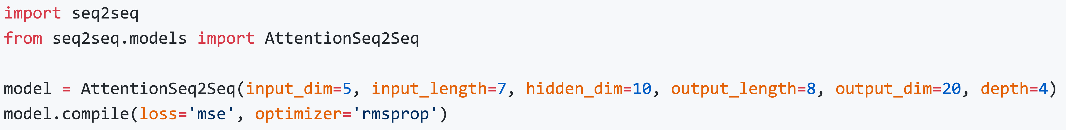
Implementation using Keras
Seq2Seq
Seq2Seq with peak
Seq2Seq with attention
Ref: https://github.com/farizrahman4u/seq2seq

Slide 25
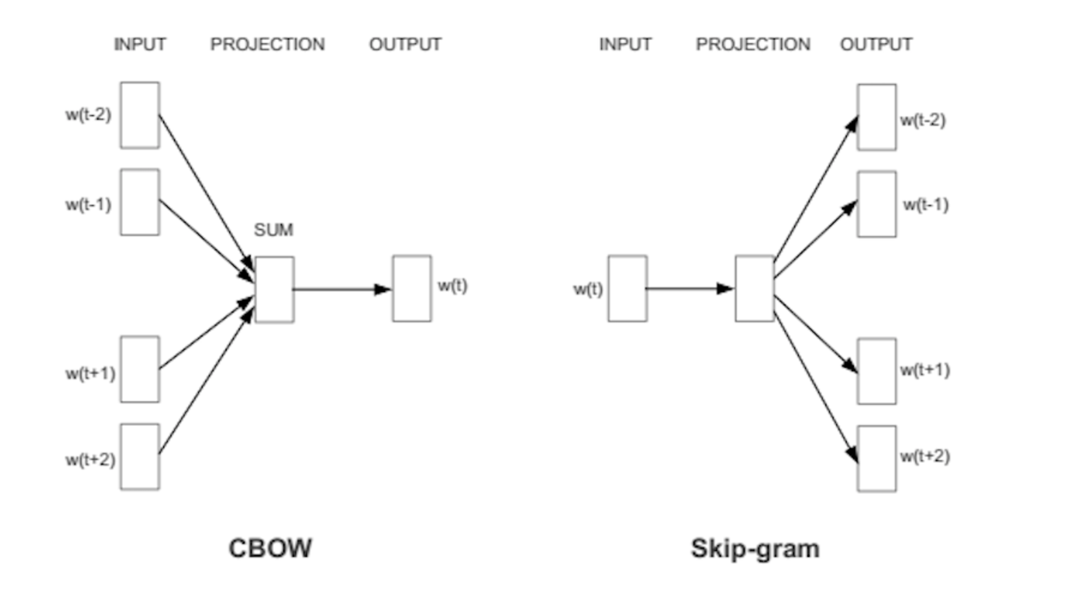
Word2vec
How to convert words into vectors?

Slide 26
Word2vec implementation
Open python IDE (for example PyCharm Community edition)
Run word2vec.py
https://github.com/tensorflow/tensorflow/blob/r1.3/tensorflow/examples/tutorials/word2vec/word2vec_basic.py

Slide 27
How to design a Keras model
(funamental_keras_model.py)
http://machinelearningmastery.com/tutorial-first-neural-network-python-keras/

Slide 28
The magic of Language Translation

Slide 29
The ‘how’ of NMT
Seq2Seq
Encoder-decoder
+ Attention
+ Language Model
+ Multi language translation
+ Reinforced Learning
+ Mutual dependency between target and source language
+ Beam search diversity scoring
+ Augmentation through back translation
+ Multiple layers
+ Residual connection
+ Low precision arithmetic
+ sub-word morphemes
+ Beam search length normalization & coverage penalty

Slide 30
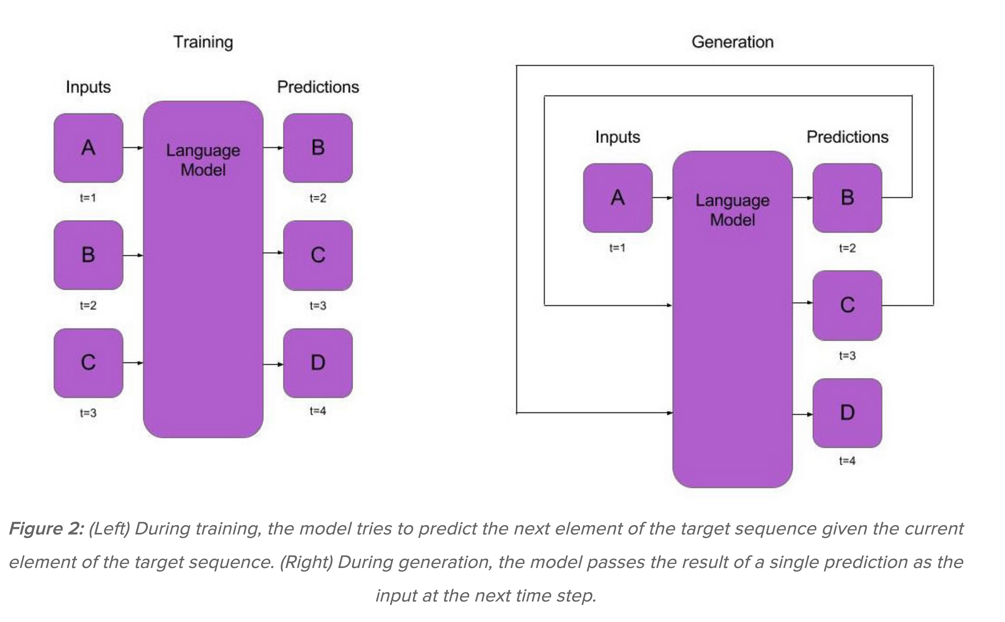
What is a language model
https://indico.io/blog/sequence-modeling-neuralnets-part1/

Slide 31
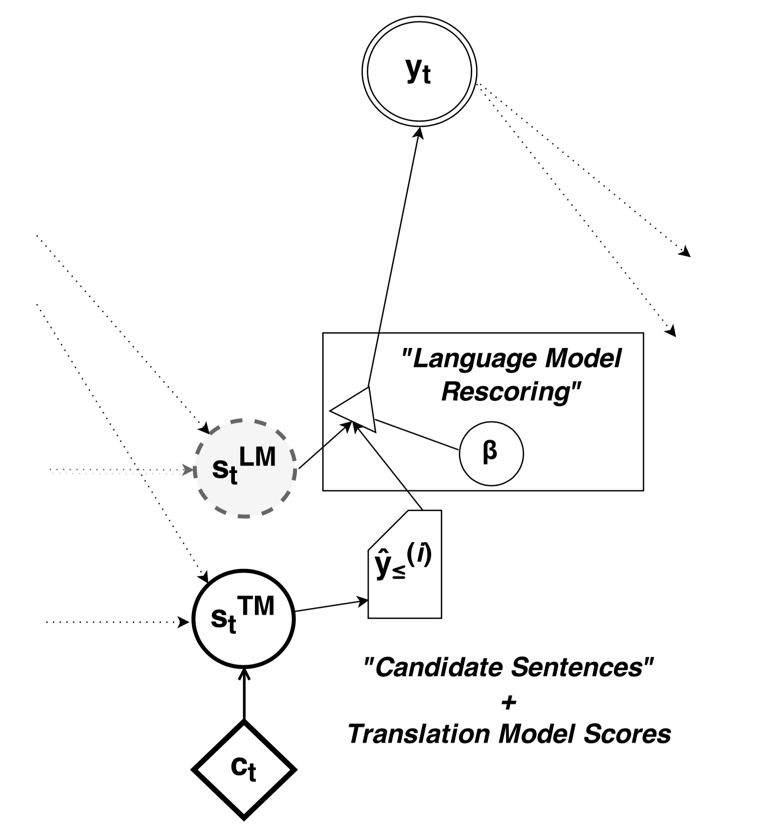
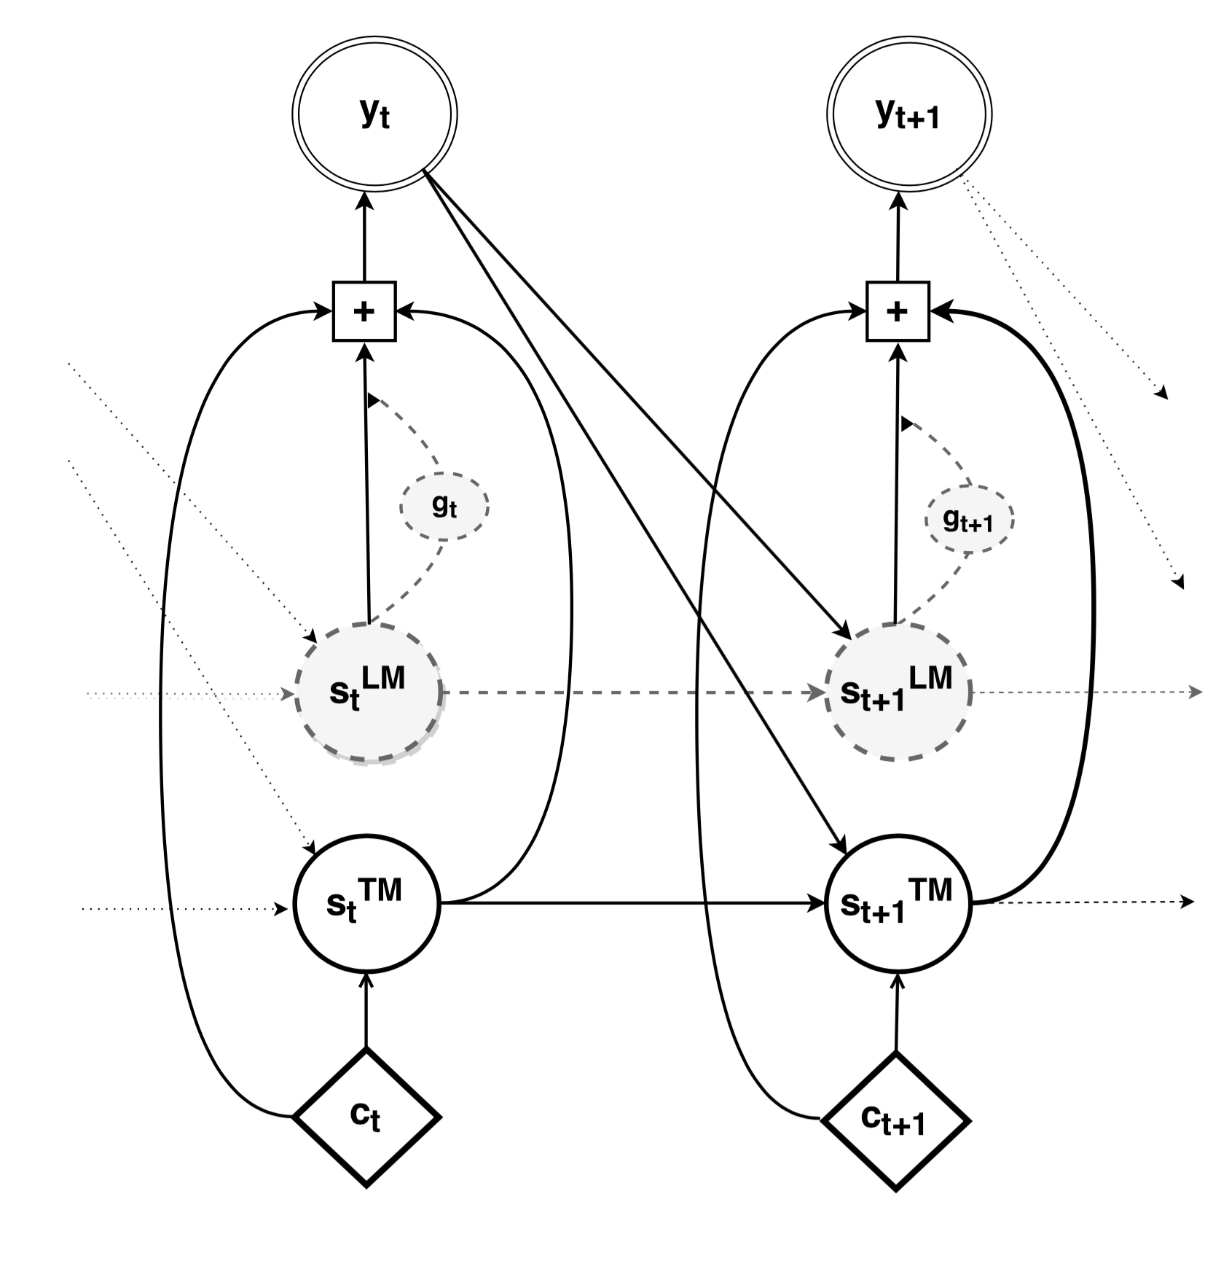
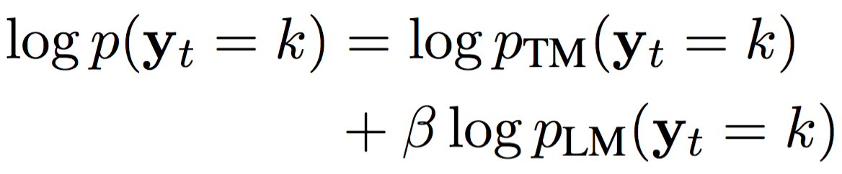
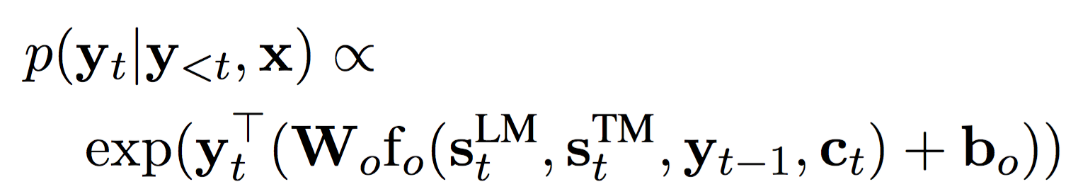
Integration of Language Model (RNNLM) with NMT
Deep fusion
Shallow fusion
Ref: On Using Monolingual Corpora in Neural Machine Translation by Gulcehre et al., https://arxiv.org/pdf/1503.03535.pdf

Slide 32
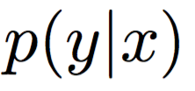
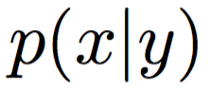
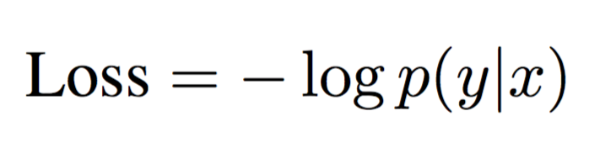
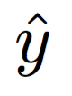
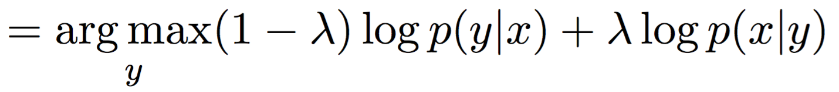
Bi-directional dependency of source and target
To eliminate UNKs:
During training, identify word-alignments of word-pairs from source and target sentences using attention models
Extract these word-alignments to create a dictionary
During testing/inference, if a UNK is created in target sentences, replace it with word in source sentence
To increase Max Mutual Info (MMI)
Train two separate Seq2Seq models, one for and one for
is used to generate N-best target sentences for the input sentence
is used to re-rank the target sentences
A typical objective function is,
A MMI based objective function is
Mutual Information and Diverse Decoding Improve Neural Machine Translation by Li et. al., https://arxiv.org/pdf/1601.00372.pdf

Slide 33
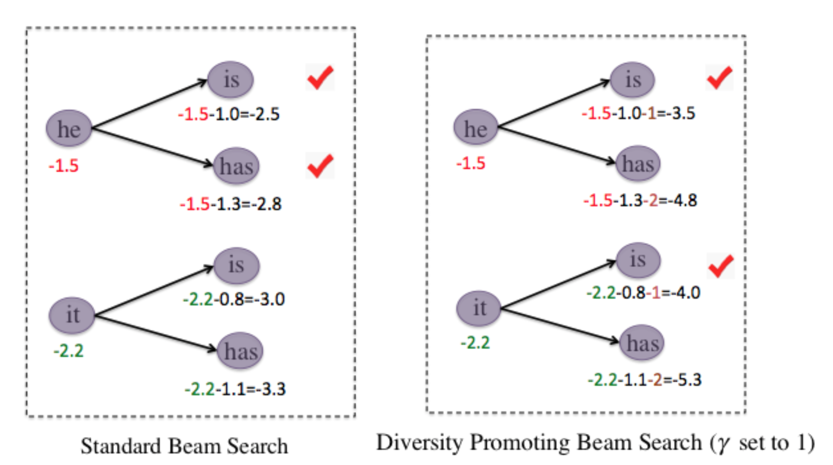
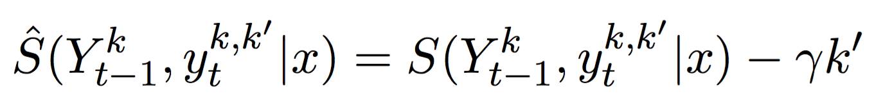
Promote diversity in target sentences
Identify top K beam length searches
Rank siblings too in addition to parents
Punish lower-ranking siblings
Beam search scoring
Beam search plus diversity scoring
Ref: Mutual Information and Diverse Decoding Improve Neural Machine Translation by Li et. al., https://arxiv.org/pdf/1601.00372.pdf

Slide 34
More tricks
Augmentation through back translation
Current
Bilingual
corpora
New
monolingual
Target
corpora
Target to Source Model
Target to Source Model
Additional
Source
corpora
Ref: MetaMind Neural Machine Translation System for WMT 2016 by Bradbury et al., http://anthology.aclweb.org/W/W16/W16-2308.pdf

Slide 35
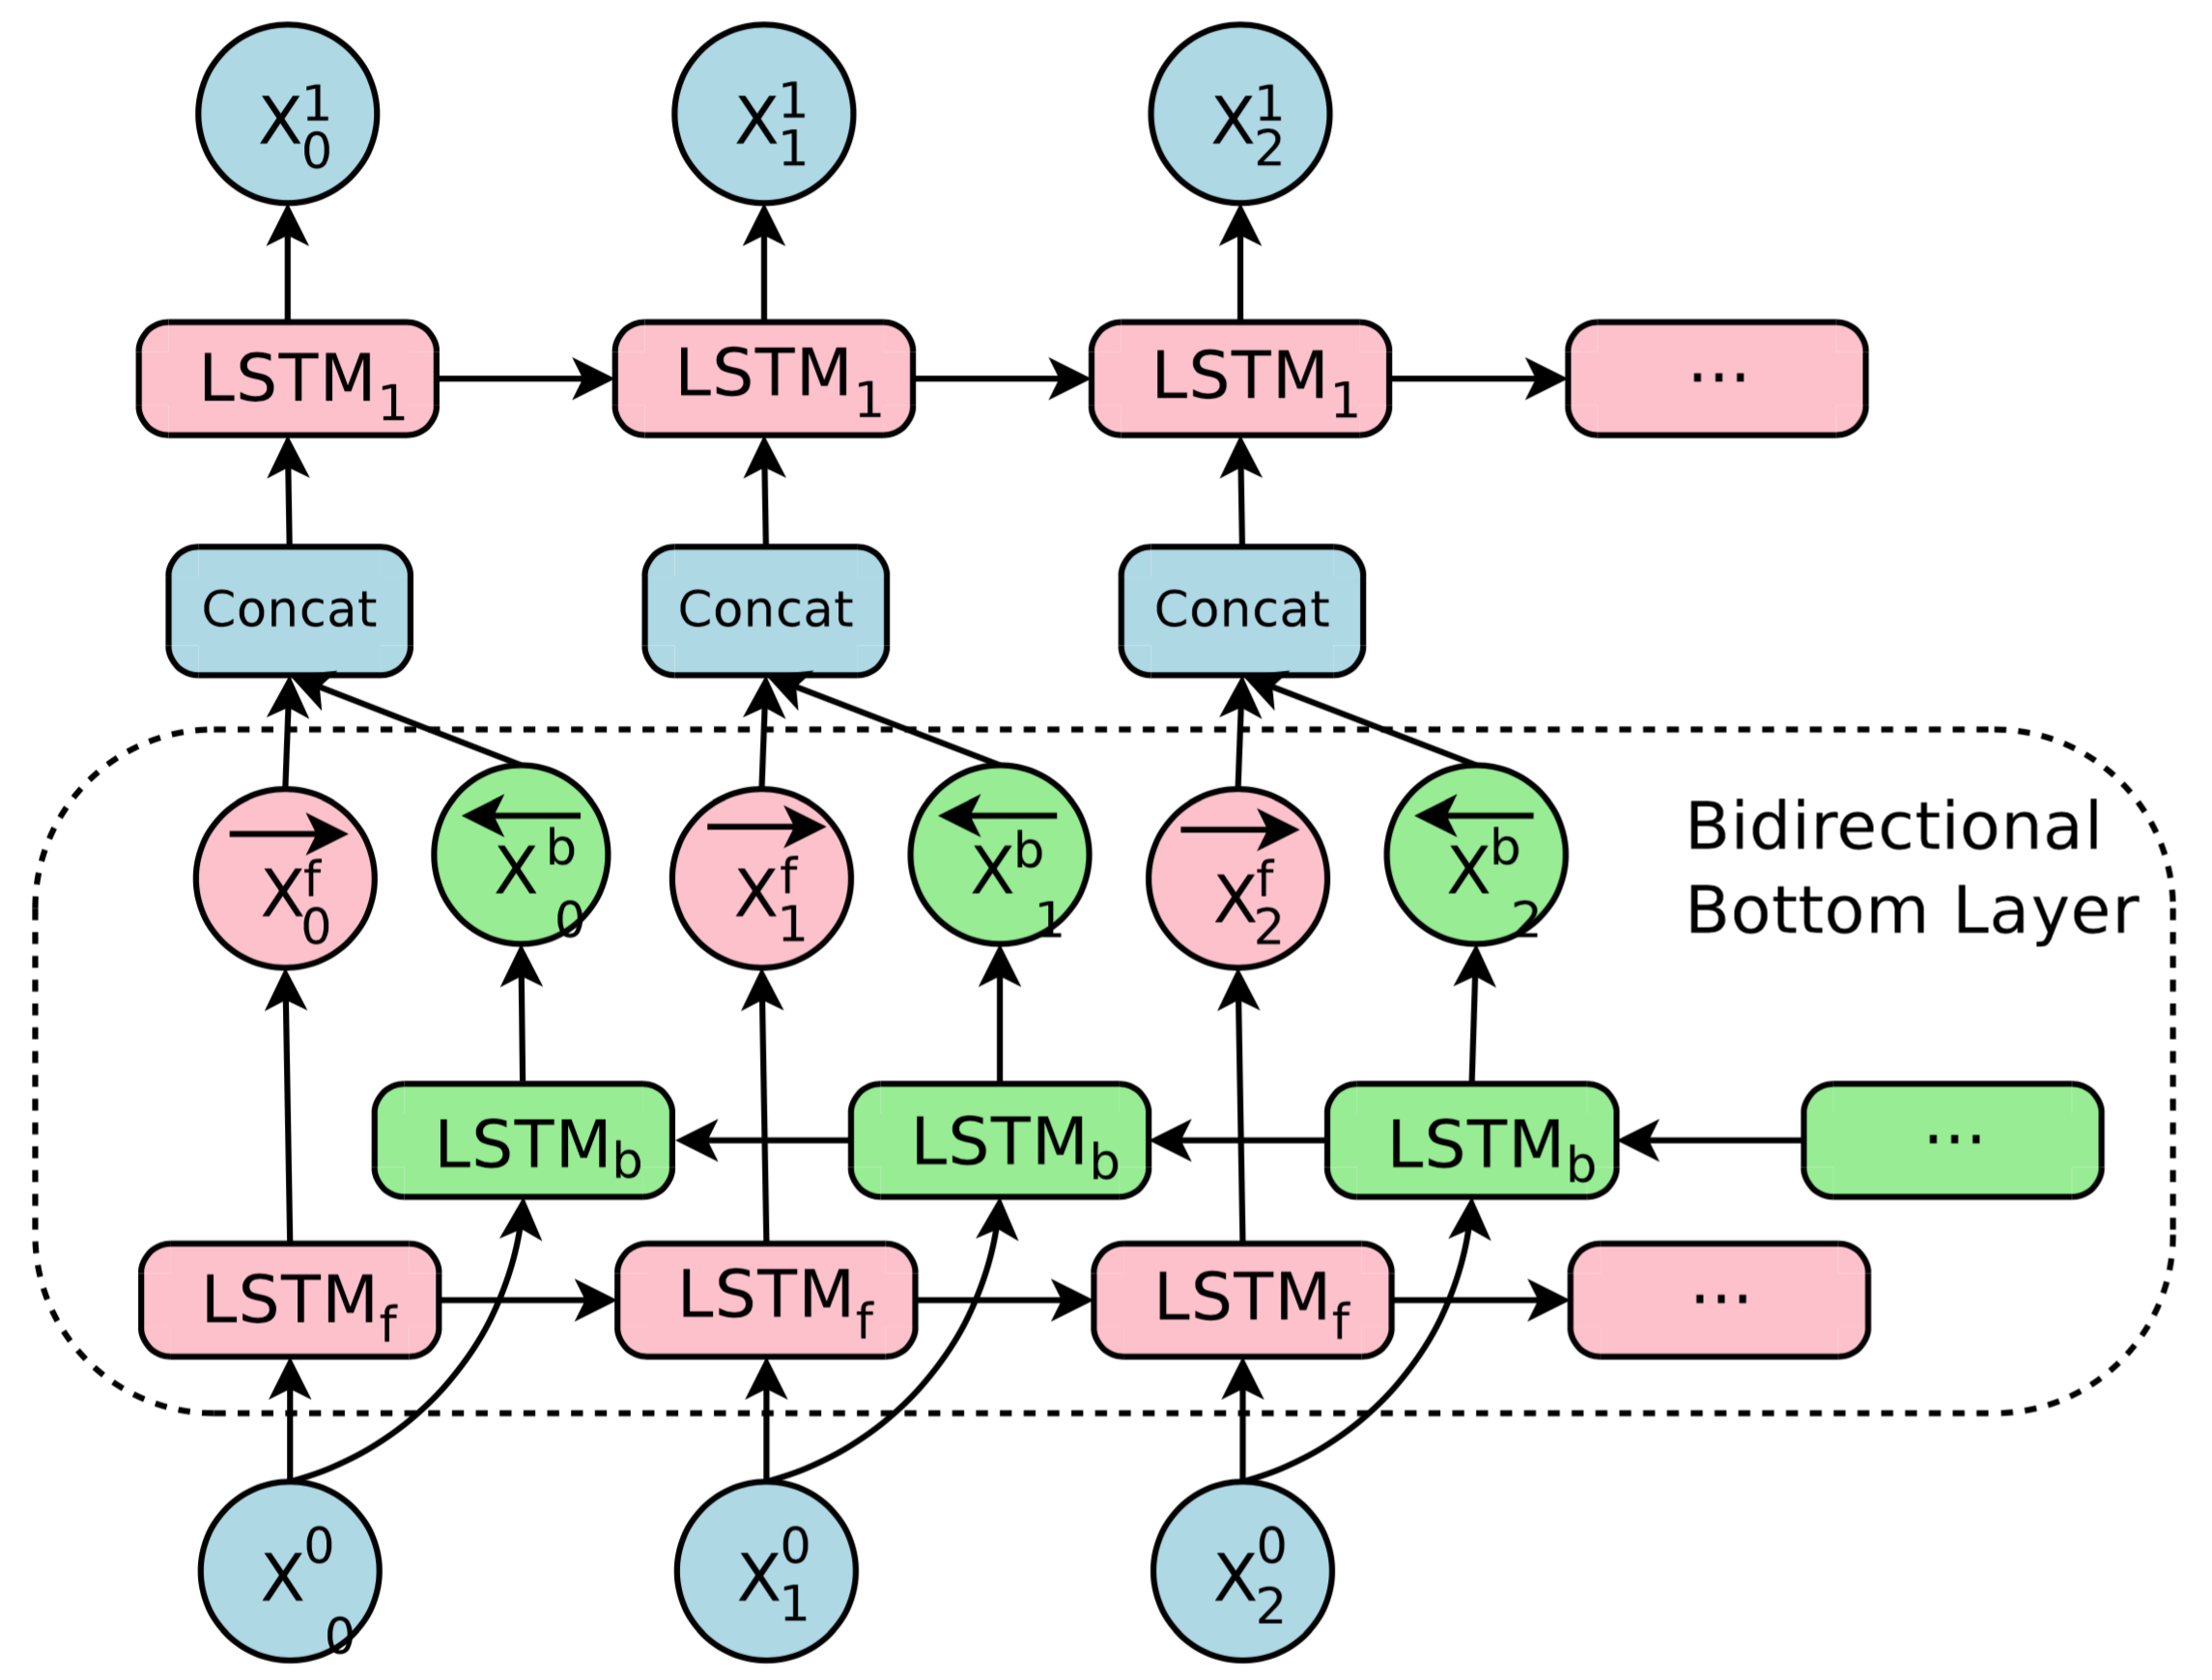
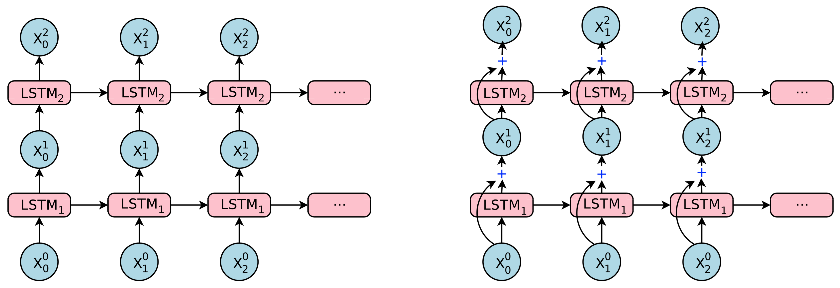
GNMT…
Bi-Directional encoder for Layer1
Residual connections
Plain stacked LSTMs
LSTMs with residual connections
8 layer encoder and 8 layer decoder
Bi-Directional encoder in layer1
Residual connections
Attention (from bottom to top)
Low precision arithmetic during inference
Beam search (Length normalization & coverage penalty)
Rare words
Ref: Google’s Neural Machine Translation System: Bridging the Gap between Human and Machine Translation; https://arxiv.org/pdf/1609.08144.pdf

Slide 36

GNMT: A giant leap…
Ref: Google’s Neural Machine Translation System: Bridging the Gap between Human and Machine Translation; https://arxiv.org/pdf/1609.08144.pdf

Slide 37

Multi-Task Learning for Multiple Language Translation
Multi-task learning framework for multiple-target language translation
Ref: Multi-Task Learning for Multiple Language Translation by Daxiang Dong et al;

Slide 38
Summarization

Slide 39

Greedy search vs. Full search vs. Beam search during prediction
How to have an RNN take x as input and
arrive at a sequence y₁y₂y₃?
y_{i} is the ground truth during training and
is the previous output during prediction
Greedy search: Best prediction of the previous time-step is the input for the current time-step
Full search: Joint probability of the output sequence is highest
Beam search: Top-k joint probabilities
Ref: A Tutorial on Deep Learning by Quoc V. Le ; https://cs.stanford.edu/~quocle/tutorial2.pdf

Slide 40
Approaches to summarization
Seq2Seq
BiDirectional Seq2Seq
Re-feed Decoder
For UNKs or rare words, copy from input (hence smaller output vocab)
Attention
Re-read inputs

Slide 41






A Deep Reinforced Model for Abstractive Summarization
Output RNN
Input RNN
Teacher forcing (word to word comparison) vs. Reinforced Learning (summary to summary)
Ref: A Deep Reinforced Model for Abstractive Summarization; R Paulus, C Xiong, R Socher; https://arxiv.org/pdf/1705.04304.pdf

Slide 42


Neural Intra-Attention Model
To avoid repetition, set
for a tri-gram
Ref: A Deep Reinforced Model for Abstractive Summarization; R Paulus, C Xiong, R Socher; https://arxiv.org/pdf/1705.04304.pdf

Slide 43






Read again & copy model
Read again in encoder; Copy words in decoder
Encoder
Decoder
Ref: EFFICIENT SUMMARIZATION WITH READ-AGAIN AND COPY MECHANISM, Zeng et al; https://arxiv.org/pdf/1611.03382.pdf

Slide 44


Read again encoder
Ref: EFFICIENT SUMMARIZATION WITH READ-AGAIN AND COPY MECHANISM, Zeng et al; https://arxiv.org/pdf/1611.03382.pdf
Hierarchical Read again encoder
(for multiple sentences)

Slide 45
Teaching computers to comprehend (Question-Answering)

Slide 46

IR-based factoid question answering has three stages: question processing, passage retrieval, and answer processing
Ref: Speech and Language Processing. Daniel Jurafsky & James H. Martin. https://web.stanford.edu/~jurafsky/slp3/28.pdf

Slide 47

Original and anonymized version of a data point from the Daily Mail validation set
Ref: Teaching Machines to Read and Comprehend; https://arxiv.org/pdf/1506.03340.pdf

Slide 48

Ref: The goldilocks principle: Reading children’s books with explicit memory representations; https://arxiv.org/pdf/1511.02301.pdf

Slide 49

Document and query embedding models
Ref: Teaching Machines to Read and Comprehend; https://arxiv.org/pdf/1506.03340.pdf

Slide 50


Impatient Reader
Ref: Teaching Machines to Read and Comprehend; https://arxiv.org/pdf/1506.03340.pdf

Slide 51

Ref: The goldilocks principle: Reading children’s books with explicit memory representations; https://arxiv.org/pdf/1511.02301.pdf

Slide 52
Hands on: Generate text
Open python IDE (for example PyCharm Community edition)
Create a LSTM network (weights_generation.py) (Took 36hrs in iMac)
Generate text with the network (generate_text.py)
Not impressed with the results? To get even better results:
Create a Large LSTM network (weights_generation_largeLSTM.py) (Took 56 hrs in iMac)
Use a larger LSTM network (generate_text_largeLSTM.py)
Ref: http://machinelearningmastery.com/text-generation-lstm-recurrent-neural-networks-python-keras/

Slide 53
Thank you
SK Reddy
skreddy99@gmail.com

